Slide 1
STOR 455 Cross Validation and Model Diagnostics
Read: 4.1, 4.3, 4.4
Exercises: 4.8, 9, 10, 12

Slide 2
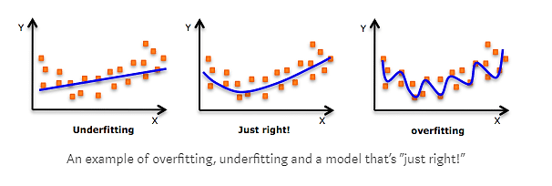
Overfitting
Concern: A model may reflect the structure of a particular sample, but not generalize well to the population.

Slide 3
Cross Validation
Concern: A model may reflect the structure of a particular sample, but not generalize well to the population.
To see if this is a problem:
Split the original sample into two parts
(a) A “training” sample to build a model
(b) A “holdout” sample to test the model

Slide 4
Example: Pulse Rates
Response Variable:
Active pulse
Predictors:
Resting pulse
Hgt
Wgt
Sex (0=M, 1=F)
Smoke (0=No, 1=Yes)
Exercise (1=Slight, 2=Moderate, 3=Lots)

Slide 5
Example: Active Pulse Rates
Training sample – first 300 cases (PulseTrain)
Holdout sample – #301-375 (PulseHoldout)
set.seed(12345)
rows <- sample(nrow(Pulse))
Pulse_shuffled = Pulse [rows,]
PulseTrain= Pulse_shuffled [1:300,]
PulseHoldout= Pulse_shuffled [301:375,]
What is the best model to predict Active pulse?

Slide 6
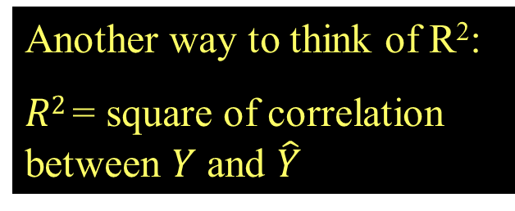
Fit for Training Model
PulseTrainMod=lm(Active~Rest+Sex+Hgt+Wgt,data=PulseTrain)
Another way to think of R²:
$R2$= square of correlation between $Y$ and $\hat{Y}$
Call:
lm(formula = Active ~ Rest + Sex + Hgt + Wgt, data = PulseTrain)
Residuals:
Min 1Q Median 3Q Max
-34.869 -8.916 -2.794 6.515 68.782
Coefficients:
Estimate Std. Error t value Pr(>|t|)
(Intercept) 33.70967 23.49083 1.435 0.15234
Rest 1.19626 0.08650 13.830 < 2e-16 ***
Sex 4.30152 2.51881 1.708 0.08873 .
Hgt -0.69392 0.35542 -1.952 0.05184 .
Wgt 0.11892 0.04128 2.881 0.00426 **
---
Signif. codes: 0 ‘***’ 0.001 ‘**’ 0.01 ‘*’ 0.05 ‘.’ 0.1 ‘ ’ 1
Residual standard error: 14.44 on 295 degrees of freedom
Multiple R-squared: 0.4216, Adjusted R-squared: 0.4137
F-statistic: 53.75 on 4 and 295 DF, p-value: < 2.2e-16

Slide 7
How does the training model work for the holdout sample?
Compute predicted values for the holdout sample using the fitted prediction equation from the training.
fitActive=predict(mod,newdata=PulseHoldout)
Compute the residuals for the holdout sample.
holdoutresid=PulseHoldout$Active - fitActive

Slide 8
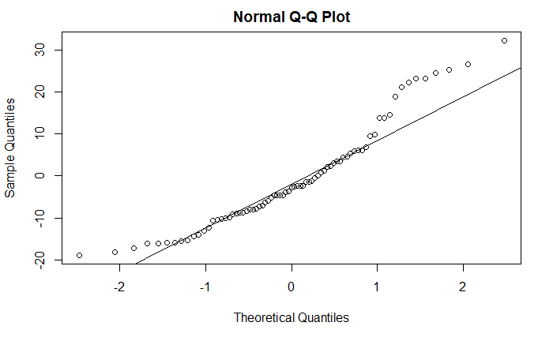

Check the Holdout Residuals
Compute mean and std. deviation of residuals.
Is the mean near zero? Is std. dev. near ${\hat{σ}}_{ε}$?
mean(holdoutresid)
[1] -0.826801
sd(holdoutresid)
[1] 12.21473
A bit biased (predictions too low), slightly less variability in errors.
Are the differences from expected close to 0 in terms of the scale of the data?
Is this skew also present in the residual diagnostics of the training data?

Slide 9
Cross Validation Correlation and Shrinkage
Compute the correlation between predicted and actual response values for the holdout sample. This is known as the cross validation correlation.
cor(PulseHoldout$Active,fitActive)
[1] 0.6474953

Slide 10
Shrinkage
Square the correlation to get a cross validation R² and compare it to R² for the training sample
Since the model was optimized for the training sample, we expect less R² for the holdout.
The difference (Training R² – Holdout R²) is known as shrinkage.
crosscorr=cor(PulseHoldout$Active,fitActive)
crosscorr
[1] 0.6474953
crosscorr^2
[1] 0.4192502
0.4216-crosscorr^2
[1] 0.002325805
The shrinkage (0.0023) is great. The training model seemed to perform as well on the holdout sample as it did on the data it was optimized for.

Slide 11
Types of “Unusual” Points in SLM
Outlier: A data point that is far from the regression line.
Influential point: A data point that has a large effect on the regression fit.
How do we measure “far”?
How do we measure “effect on the fit”?

Slide 12
Detecting Unusual Cases - Overview
1. Compute residuals
“raw”, standardized, studentized
2. Plots of residuals (or std. residuals)
Boxplot, scatterplot, normal plot
3. Leverage
Unusual values for the predictors
4. Cook’s distance
Cases with large influence

Slide 13

Standardized Residuals
For residuals: mean=0 and std. dev. $≈{\hat{σ}}_{ε}$
Look for values
beyond ±2 (mild) or beyond ±3
Standardized Residual ≈
(almost)
Definition: The standardized residuals are:
Leverage

Slide 14
Studentized Residuals
Definition: The studentized residuals are:
Using model fit without i^{th} case

Slide 15
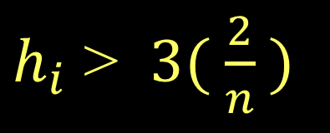
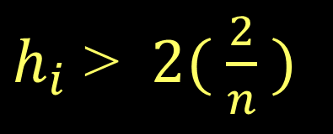
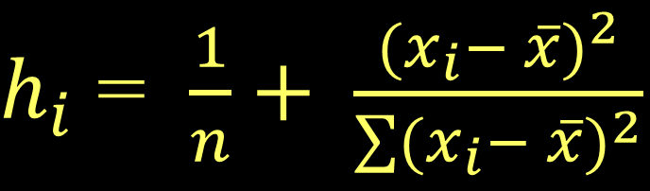
Leverage in Simple Linear Regression
$h_{i}$ = $\frac{1}{n}+ \frac{{(x_{i}− \overline{x})}^{2}}{\sum{{(x_{i}− \overline{x})}^{2}}}$
For a simple linear model:
= 1+ 1 = 2
Look for:
$h_{i}$ > $2( \frac{2}{n} )$
or
$h_{i}$ > $3( \frac{2}{n} )$

Slide 16
Leverage in Multiple Regression
For a multiple regression with k predictors:
Look for:
or

Slide 17

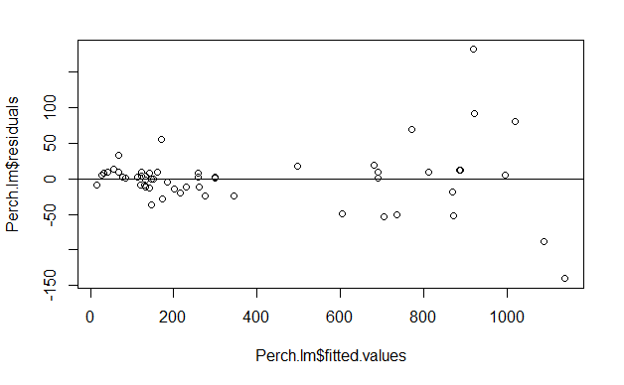
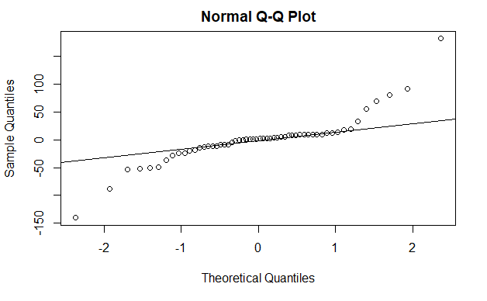
Leverage in Multiple Regression: Perch
Perch_lm = lm(Weight~Length+Width+Width*Length, data=Perch)
plot(Perch_lm$residuals~Perch_lm$fitted.values)
abline(0,0)

Slide 18
Leverage in Multiple Regression: Perch
2*(3+1)/56
3*(3+1)/56
head(sort(hatvalues(Perch_lm), decreasing=TRUE), n=8)
[1] 0.1428571
[1] 0.2142857
1 40 2 55 56 46 52
0.4313620 0.3628595 0.1529084 0.1509016 0.1434099 0.1396390 0.1205529
54
0.1124513

Slide 19
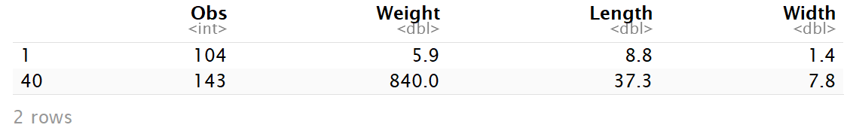
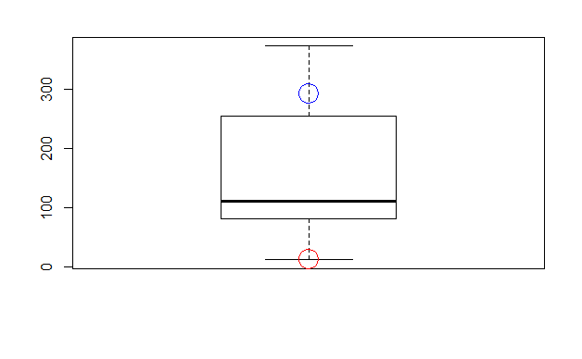
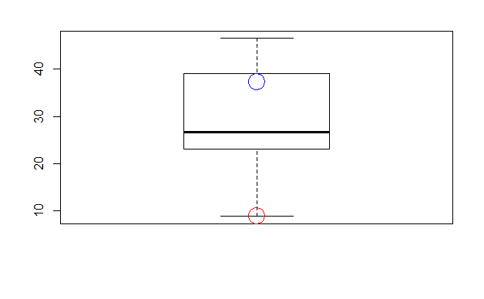
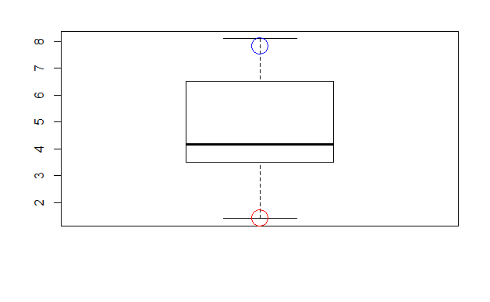
Leverage in Multiple Regression: Perch
Perch[c(1,40),]
boxplot(Perch$Length*Perch$Width, main="Length*Width")
points(Perch$Length[1]*Perch$Width[1], col="red", cex=3)
points(Perch$Length[40]*Perch$Width[40], col="blue", cex=3)
boxplot(Perch$Length, main="Length")
points(Perch$Length[1], col="red", cex=3)
points(Perch$Length[40], col="blue", cex=3)
boxplot(Perch$Width, main="Width")
points(Perch$Width[1], col="red", cex=3)
points(Perch$Width[40], col="blue", cex=3))

Slide 20
Cook’s Distance
How much would the fit change if one data value were omitted?
D_{i} increases with either poor fit (std.res_{i}) and high leverage (h_{i}).
Compare to other D_{i}’s.
Study any case with D_{i} > 0.5; worry if D_{i} > 1.0.

Slide 21
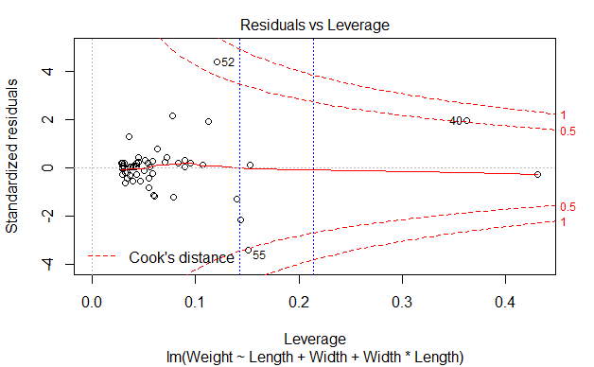
Cook’s Distance
plot(Perch_lm)
abline(v = 2*(3+1)/56, col="blue", lty=3)
abline(v = 3*(3+1)/56, col="blue", lty=3)

